Slide 1
Terraform Bootcamp: Week-1 Intensive Training
Infrastructure as Code (IaC) for Modern Cloud Operation Presented by: Tahira Murtaza

Slide 2
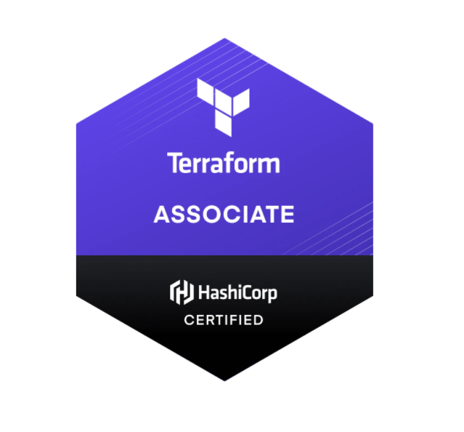
Introduction to Terraform
What is Terraform?
Open-source IaC tool by HashiCorp
Declarative configuration language for managing infrastructure
Key Benefits:
Automates infrastructure provisioning
Multi-cloud support (AWS, Azure, GCP, etc.)
Version-controlled, scalable, and reproducible environments

Slide 3
Why Terraform?
Challenges in Modern Cloud Infrastructure:
- Complexity of multi-cloud environments
- Infrastructure drift
- Scaling and managing resources
Terraform Benefits:
- Write once, deploy everywhere
- Declarative and idempotent execution
- Collaborate with teams through version control

Slide 4
Terraform Bootcamp Overview
Duration: 1 Week
Target Audience: DevOps Engineers, Cloud Architects, System Administrators, and Developers
Learning Outcomes:
- Understanding Terraform architecture
- Creating and managing infrastructure using Terraform
- Applying best practices for Terraform workflows
- Automating deployment on multiple cloud providers

Slide 5
Week 1 Agenda
Day 1: Introduction to Terraform and Setup
- Install Terraform
- Terraform CLI basics
- Overview of Providers, Resources, and State

Slide 6
Day 2: Writing Terraform Configuration
- Variables, Outputs, and Modules
- Resources and Data Sources
- Hands-on: Create resources on AWS
Day 3: Terraform State and Workspaces
- Managing state files
- Remote state and locking
- Workspaces for environment management

Slide 7
Day 4: Terraform Plan and Apply
- Terraform Plan command
- Apply, destroy, and refresh operations
- Best practices in executing Terraform
Day 5: Managing Infrastructure with Terraform
- Refactoring and organizing configurations
- Implementing Terraform in CI/CD pipelines
- Real-world project scenario (team hands-on)

Slide 8
Terraform Core Concepts
Providers:
- What are providers and how do they work?
- AWS, Azure, GCP, Kubernetes, etc.
Resources:
- Declarative syntax to define cloud resources
- Example: EC2 instance, S3 bucket
State:
- Tracks your infrastructure's current state
- Local vs. remote state
- Benefits of remote state (e.g., S3 + DynamoDB)

Slide 9
Hands-on Labs (Day 2 Example)
Lab 1: Provisioning AWS EC2 Instance
- Set up an EC2 instance with a security group and key pair
- Use Terraform to automate the creation
Lab 2: Configure Outputs and Variables
- Using variables for flexibility
- Outputs for sharing data across modules

Slide 10
Managing Terraform State
State File Structure:
- What’s stored in the state file
- How to inspect and modify state files
Remote State:
- Advantages of remote state (team collaboration)
- Example: Using AWS S3 and DynamoDB for locking
Terraform State Commands:
- terraform state list, terraform state show, etc.

Slide 11
Writing Modules and Reusable Code
What are Modules?
- Encapsulation of resource configurations
- Promotes code reuse and better organization
How to Create Modules
- Directory structure
- Passing variables to modules
- Example: Reusable VPC Module

Slide 12
Terraform in CI/CD Pipelines
Terraform CLI in Automation:
- Integrate Terraform with Jenkins, GitLab CI, etc.
- Trigger Terraform runs on code changes
Workflow Example:
- Developer pushes code -> Terraform Plan -> Apply in CI/CD

Slide 13
Advanced Terraform Features
Provisioners and Data Sources
- Use provisioners for configuration management
- Pull dynamic data with data sources
Terraform Cloud/Enterprise
- Collaboration, teams, and workspace management
- Policy as code with Sentinel
- Modules from the Terraform Registry

Slide 14
Best Practices in Terraform
Code Organization:
- Use modules for separation of concerns
- Follow naming conventions
Version Control:
- Keep Terraform configuration in version control
State Management:
- Use remote backends (S3, GCS, etc.)
- Locking and encryption for state files
Security:
- Use IAM roles and not hardcoded credentials
- Store sensitive data securely (e.g., AWS Secrets Manager)

Slide 15
Wrap Up & Next Steps
Recap of Week 1:
- What was covered in the bootcamp
- Key takeaways and skills learned
Next Steps:
- Additional learning resources (Terraform documentation, tutorials)
- Practice in real-world scenarios
- Join Terraform community for ongoing support

Slide 16
Q&A
Open floor for questions and feedback from the participants

Slide 17
Thank You
Contact Info:
Email: [tahiramurtza10@gmail.com]
Phone: [+92 349 6740587]

